Slide 1









Customer
Loyalty
Program

Slide 2


MANDATORY PAGE
INTRODUCTION
01.

Slide 3

WELCOME TO OUR
PRESENTATION
Overview
Our project focuses on implementing a loyalty program tailored for retail pop-up stores.​
Importance
Customer loyalty and repeat purchases are vital for sustained success in retail businesses.​
Objectives
Our aim is to enhance customer engagement, drive repeat purchases, and foster long-term loyalty through the implementation of this loyalty program.

Slide 4
User Story
Brief Explanation
The user story revolves around enabling customers to enroll in our loyalty program, allowing them to earn rewards and receive special offers based on their purchases.​
Importance
Loyalty program enrollment is crucial for both customers and the company. It incentivizes customers to engage with our brand, fosters repeat purchases, and builds long-term loyalty. ​

Slide 5

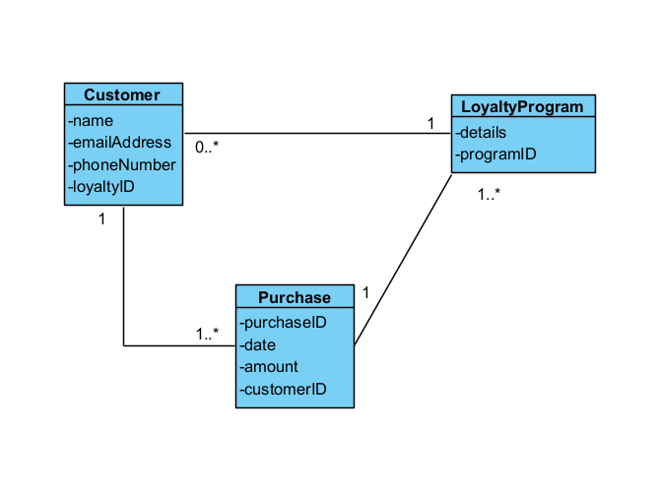
Class Diagrams
Represents the key entities involved in our loyalty program implementation and their relationships​
Entities include Customer, LoyaltyProgram and Purchase​
Relationships depict how customers are associated with the loyalty program and how purchases are linked to loyalty program IDs.​

Slide 6
Importance Of Maintaining A Structured Data Model
A structured data model ensures consistency and accuracy in storing and managing customer data and purchase information.​
It facilitates seamless interactions between different components of the loyalty program, enabling efficient tracking of customer activities and rewards.​

Slide 7

Use Case Name​ | Enroll in Loyalty Program​
Triggering Event​ | Customer wishes to enroll in the loyalty program.​
Brief Description​ | Allows a customer to enroll in the retail "pop-up" store's loyalty program.​
Actors​ | Customer​
Related Use Cases​ | ​
Preconditions​ | Customer has accessed the loyalty program enrollment section of the application.​
Post Conditions​ | Customer is successfully enrolled and can be queried if required.​
Flow of activities​ | Actor​ |  | System​
​ | 1.​ | Requests to enroll in the loyalty program.​ | Prompts the customer to provide necessary information - full name, email address, and phone number​
​ | 2.​ | Enters full name, email address and Phone Number.​ | Verifies full name, email address and Phone Number have been entered. Presents the terms and conditions of the loyalty program to the customer and prompts to agree.​
​ | 3.​ | Reads and agrees to the terms and conditions. ​ | Verifies if Agree Radio Button was checked.​ Generates a unique loyalty program ID.​ Prompts to save and exit.​
​ | 4.​ | Chooses to exit and save​ | Saves the data. ​ Displays confirmation of successful enrollment.​ Returns to the main menu.​
Exception Conditions​ | Customer declines to provide required information.​ Customer declines to agree to the terms and conditions of the loyalty program.​
Use Case Description
Importance
Capturing customer information and agreement to terms and conditions is crucial for effective enrollment. It ensures that customers understand the program's rules and allows the company to communicate with them effectively.

Slide 8
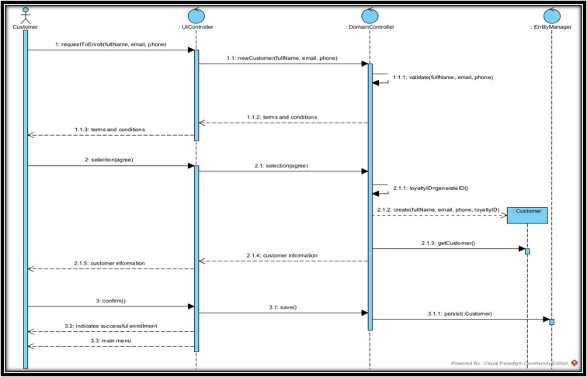
Enrolling In The Loyalty Program
The sequence diagram illustrates the interactions between objects involved in the enrollment process of the loyalty program.​
The sequence ensures a smooth and user-friendly enrollment process, guiding customers through each step while capturing essential information and ensuring agreement to program terms.​

Slide 9

Use Case Name​ | Query Loyalty Program Enrollment​
Triggering Event​ | Owner wishes to view enrolled customers in the loyalty program.​
Brief Description​ | Allows the business owner to query and view enrolled customers in the loyalty program.​
Actors​ | Owner​
Related Use Cases​ | ​
Preconditions​ | Owner has opened the Main Menu.​
Post Conditions​ | All customers enrolled in the loyalty program get displayed.​
Flow of activities​ | Actor​ |  | System​
​ | 1.​ | Requests to query enrolled customers in the loyalty program.​ | Displays a list of enrolled customers, including their names, contact information, and loyalty program IDs.​
​ | 2.​ | Chooses to cancel.​ | Returns to the main menu.​
Exception Conditions​ | Owner chooses to cancel querying loyalty program customers.​
Use Case Description
Importance
Querying loyalty program enrollment provides valuable insights into customer participation and engagement. It allows the business owner to analyze customer data, track program effectiveness, and make informed decisions to enhance the loyalty program's performance.​

Slide 10

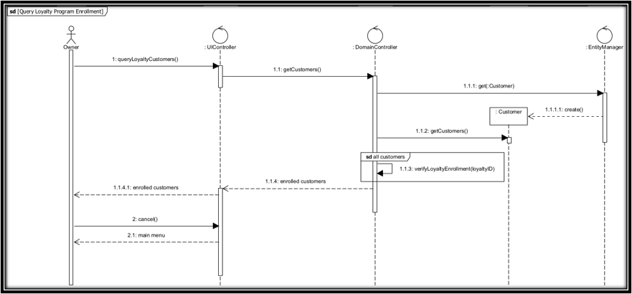
Querying The Loyalty Program
The sequence diagram illustrates the interactions between objects involved in querying enrolled customers in the loyalty program.​
The sequence enables the business owner to efficiently access and analyze customer data related to loyalty program enrollment. It facilitates informed decision-making and helps optimize the effectiveness of the loyalty program.​

Slide 11
Benefits Of The Software
Improved Customer Engagement
Enhanced Data Tracking & Analysis
The software facilitates the implementation of a loyalty program, which incentivizes customers to make repeat purchases and engage with the brand on a regular basis.​
By offering rewards and special offers, the company can enhance customer satisfaction and loyalty, leading to increased retention rates and long-term profitability.​
The software provides robust data tracking and analysis capabilities, allowing the company to gather valuable insights into customer behavior, preferences, and purchasing patterns.​
With access to comprehensive data analytics, the company can make informed decisions, tailor marketing strategies, and optimize the loyalty program to better meet the needs of its customers.​

Slide 12
THANK YOU!
We sincerely thank you for your time and attention during this presentation.​
Your interest in our project is greatly appreciated, and we value the opportunity to share our findings with you.​

